Slide 1
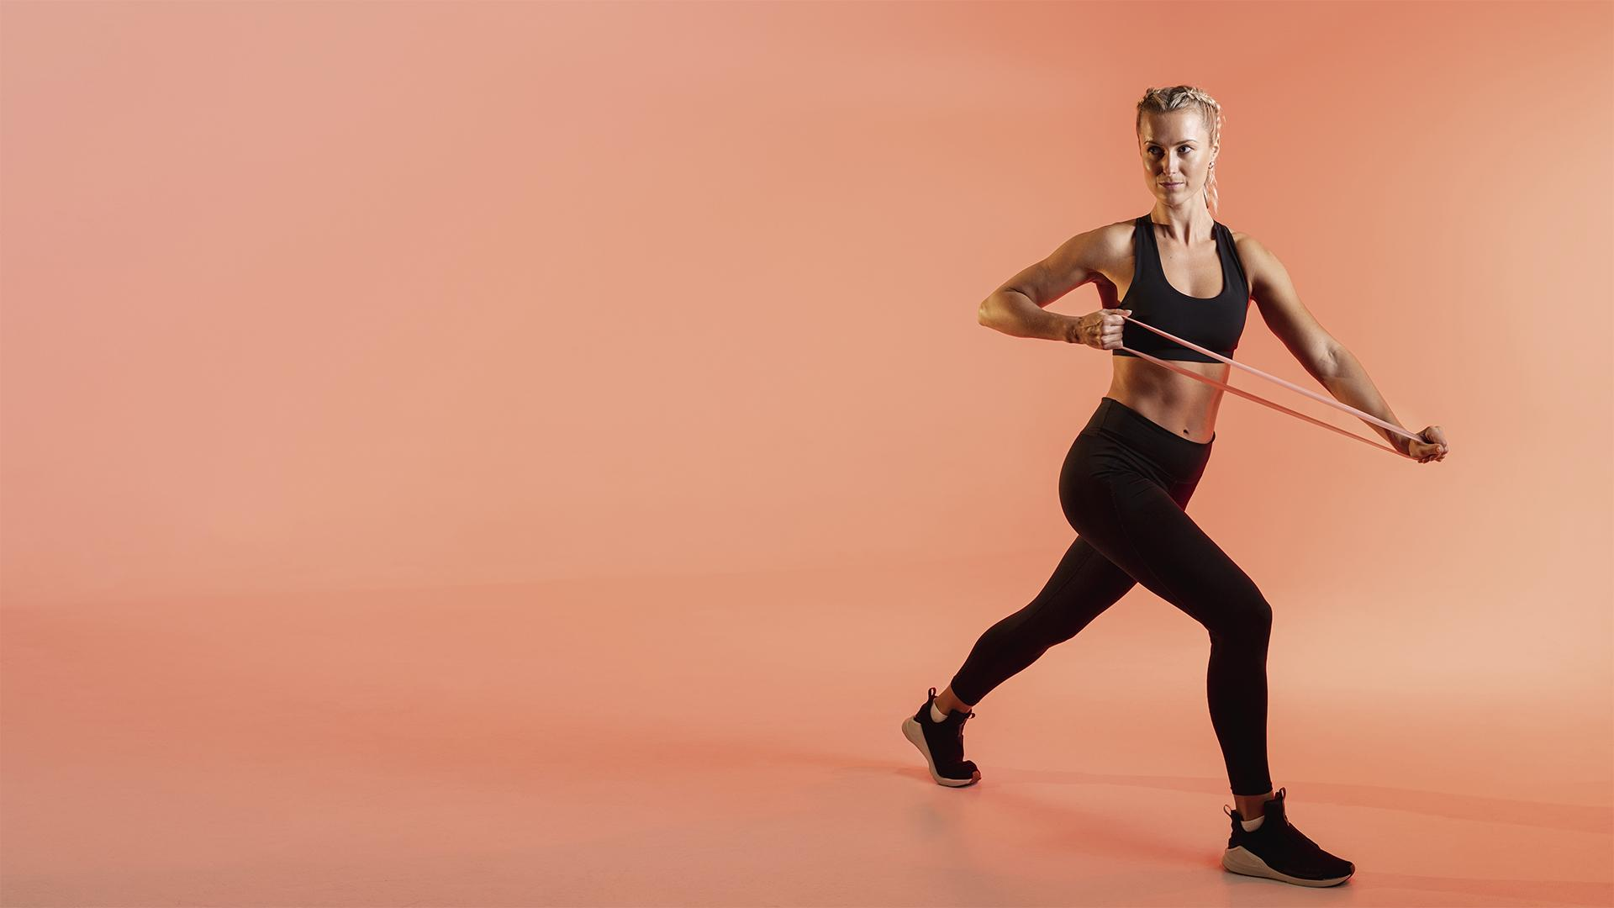
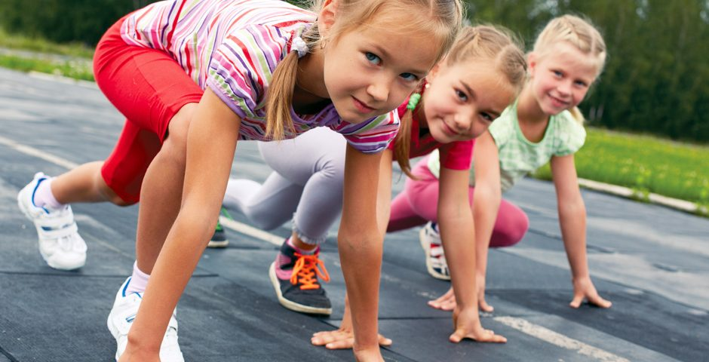
FITNESS APP
StartVaardig
Motoric skills development
Here is where your pitch deck begins
Pascal Seegers 21132844
Lisa Dumaij 19049838
Yuliya Litvin 20161417
Joost van Viegen 18048757
Mustafa Mousa 18068987
Joep van der Zanden 19134282

Slide 2
What we have done
01
Added missing functions for pipeline
Created final pipeline
External Presentation
Met Pim
Worked on research paper
2

Slide 3
Meanwhile….
Model | Before hyperparameter tuning | After
Random forest | 0.39 | 0.48
KNN | 0.25 | 0.39
3
Notes:
We have received the T0 data, but we are still waiting for the T1.
The data files we received have been combined into a single file.
We have explored the data using multiple visualisations

Slide 4
02 In progress / Next steps
Finish preparing T1 data
Finalizing final pipeline
Finishing research paper
Working on individual portfolios
Preparing for test
4
Notes:
Fit knn and RFC

Slide 5
03 Next steps
External presentation
New models
Ensembling models
(Prototype)
5
Notes:
We have received the T0 data, but we are still waiting for the T1.
The data files we received have been combined into a single file.
We have explored the data using multiple visualisations

Slide 6
THANK YOU!
6

